Slide 1
UD Reporting
Where Are We Now
Where Are We Going
How Do We Get There

Slide 2
Where are we now
Cognos Reports
  1 UD RBB
    Financial
    HR
    Student
  1 UD Student Admin Reports
    AA Deans
    Admissions
    Schedule of Class (SOC)
  1 UD Course and Workload Verification

Slide 3
1 UD RBB
Reports to support RBB
  Report definitions found on http://www.udel.edu/IR/UDEW/
  Data pulled from
    Student Enrollment Data Mart
    PeopleSoft Financial
    PeopleSoft Human Resources

Slide 4
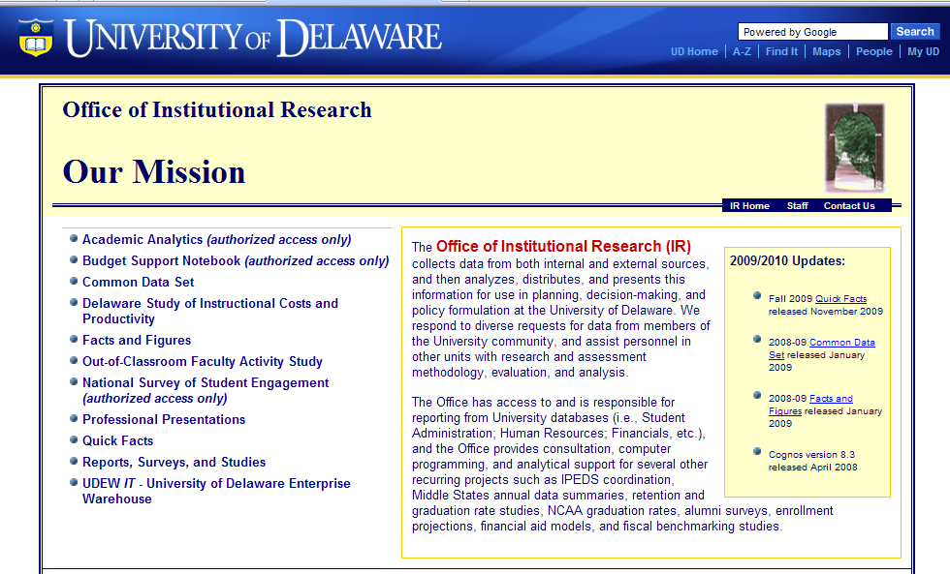
Institutional Research

Slide 5
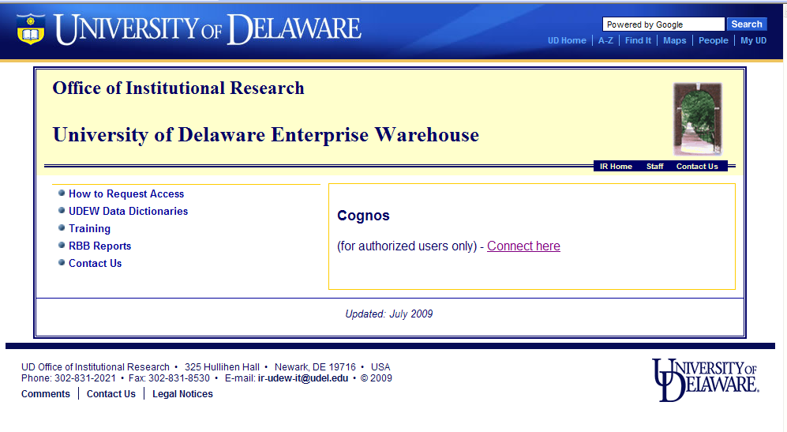
UD Enterprise Warehouse -UDEW

Slide 6
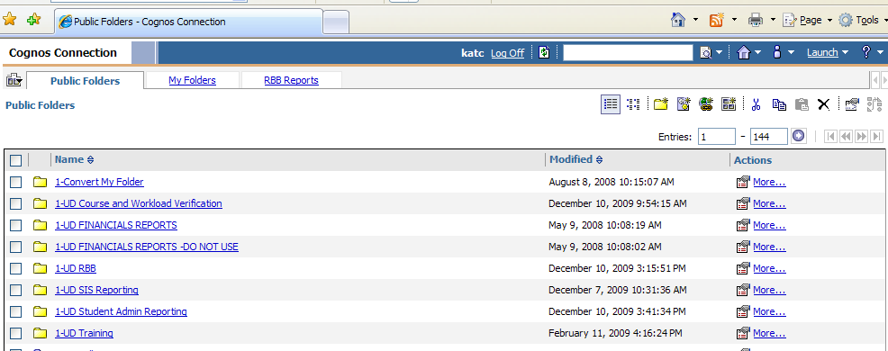
Cognos Connection

Slide 7
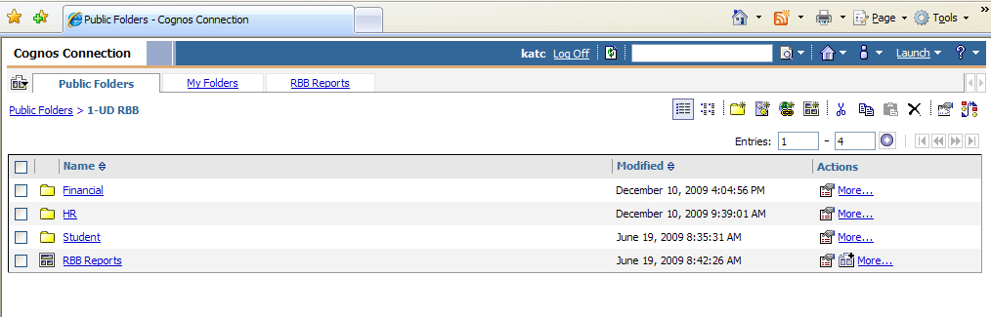
1-RBB Folder

Slide 8
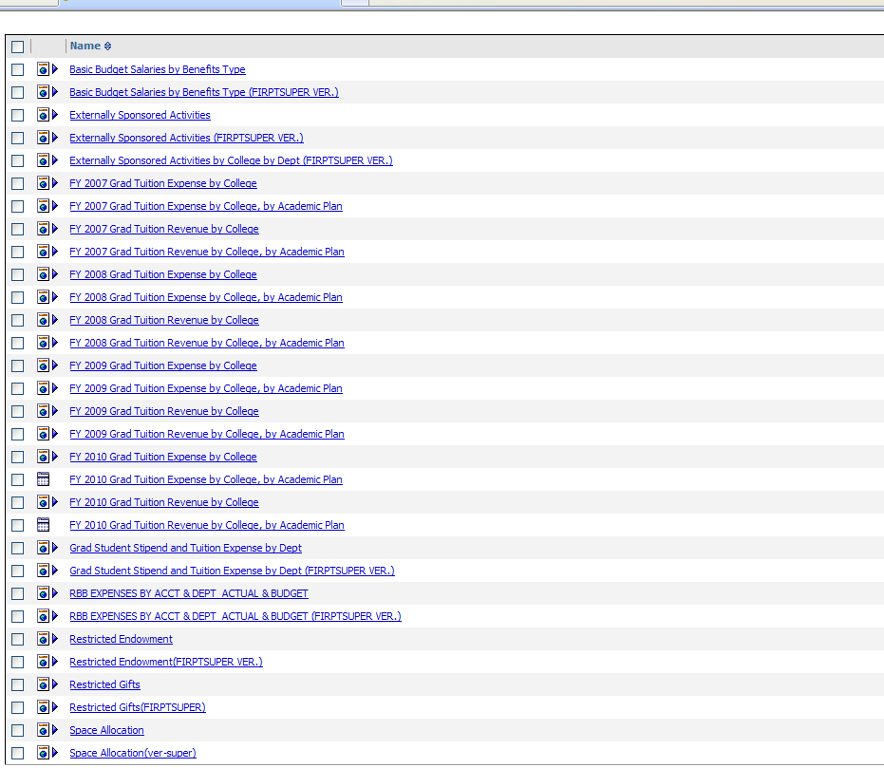
Financial Reports

Slide 9
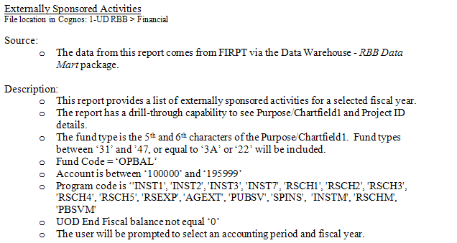
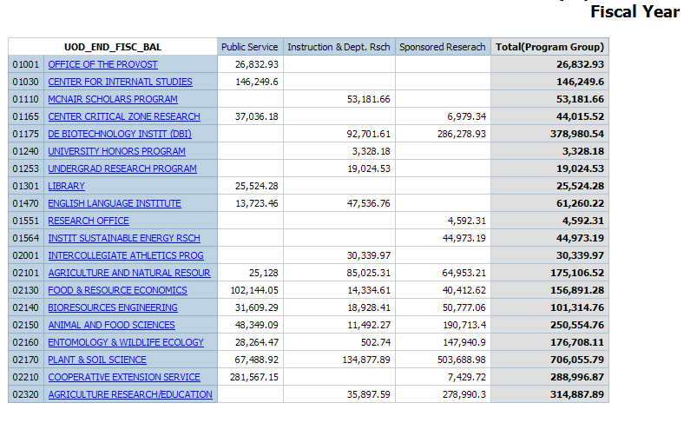
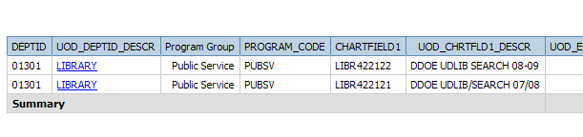
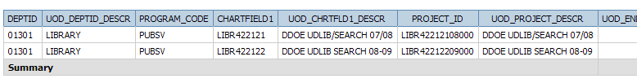
Externally
Sponsored
Activities

Slide 10
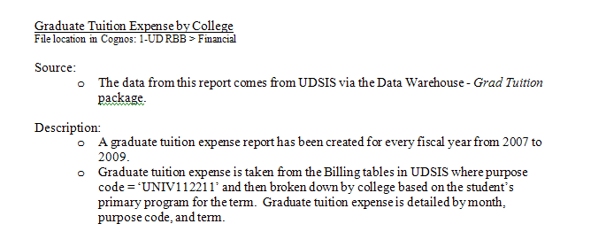
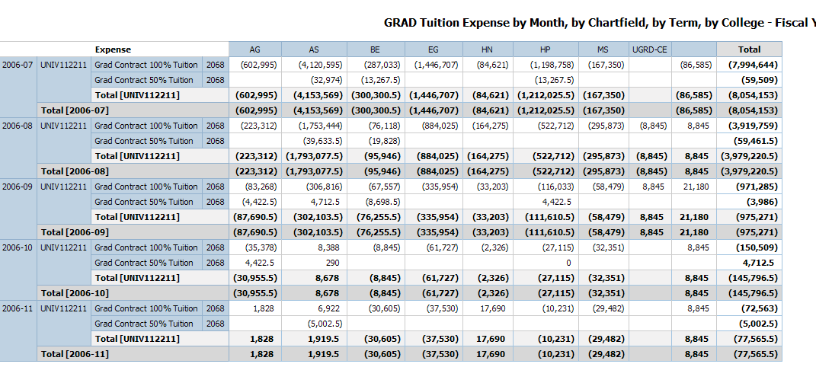
Grad Tuition
Expense by College

Slide 11
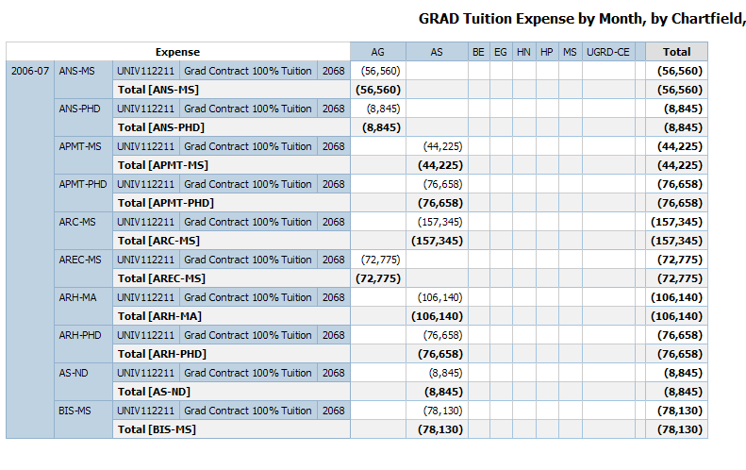
Graduate Tuition Expense by College By Academic Plan

Slide 12
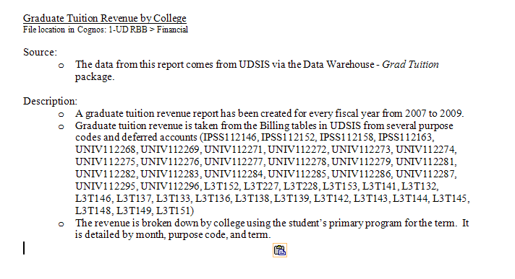
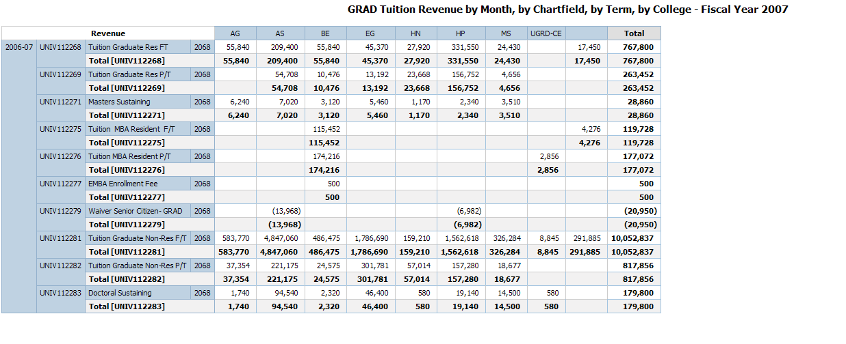
Graduate Tuition
Revenue By College

Slide 13
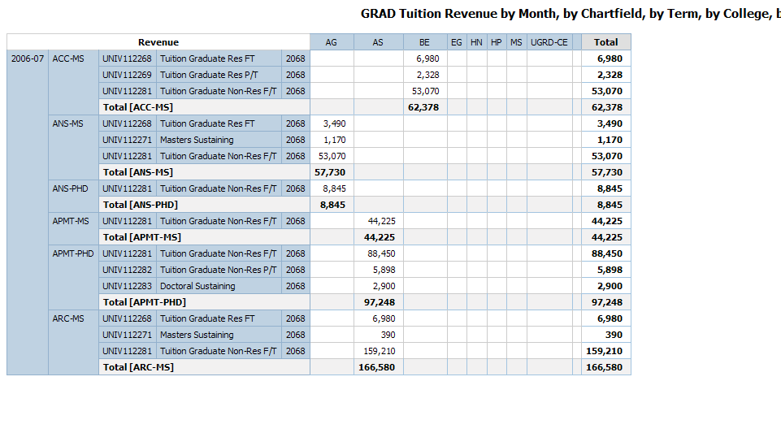
Graduate Tuition Revenue By College By Academic Plan

Slide 14
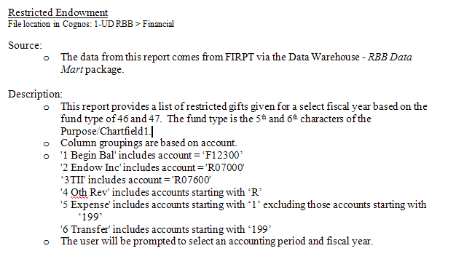
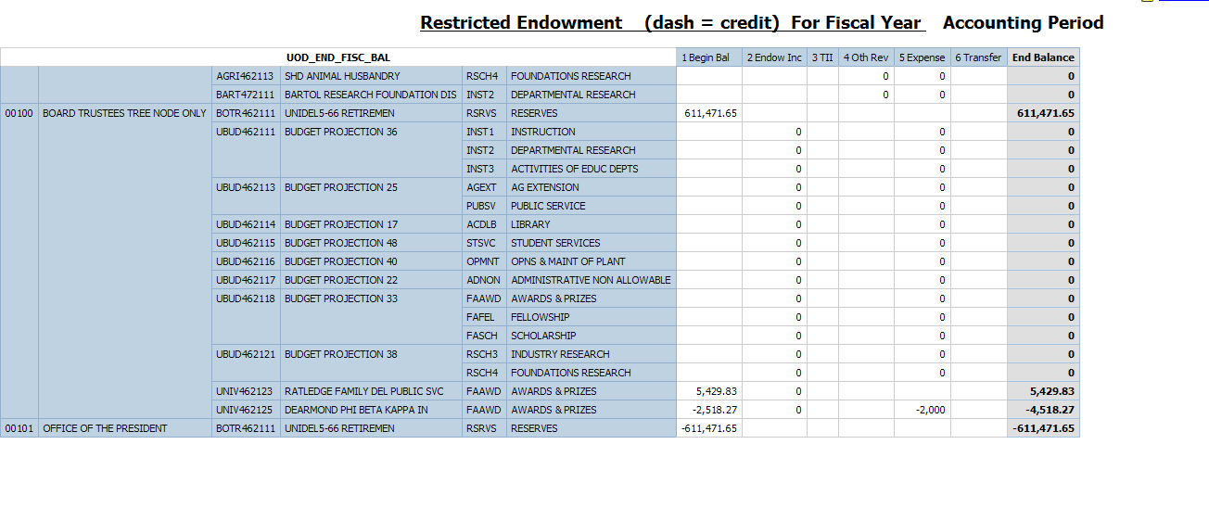
Restricted
Endowment

Slide 15
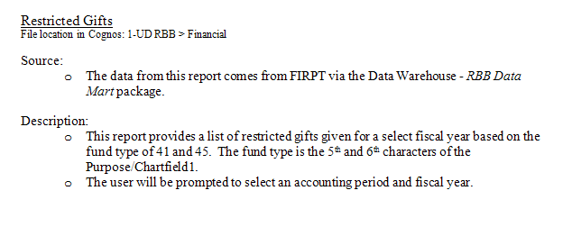
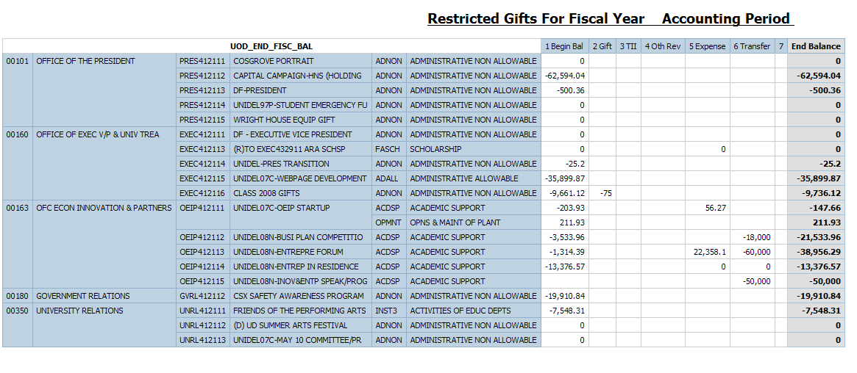
Restricted Gifts

Slide 16
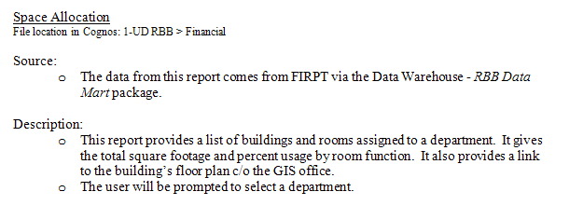
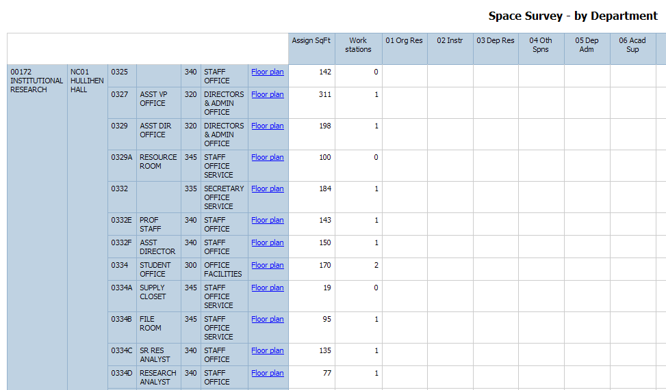
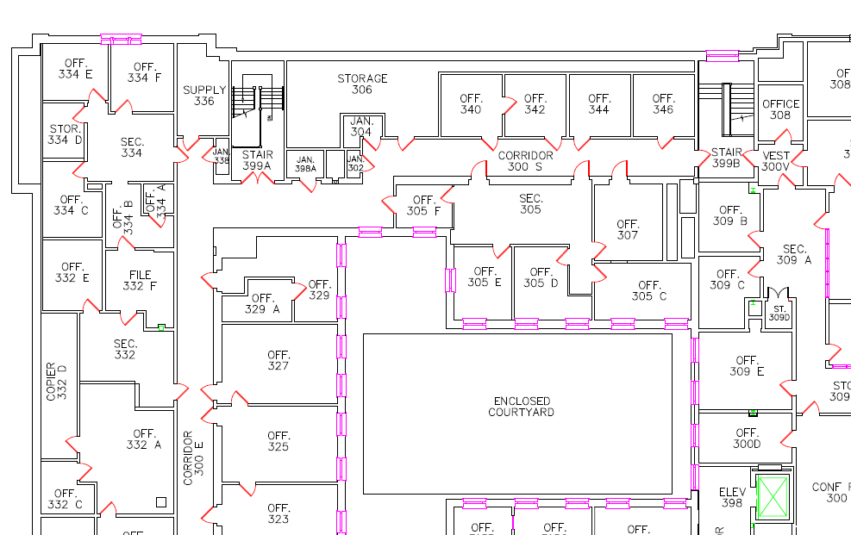
Space
Allocation

Slide 17
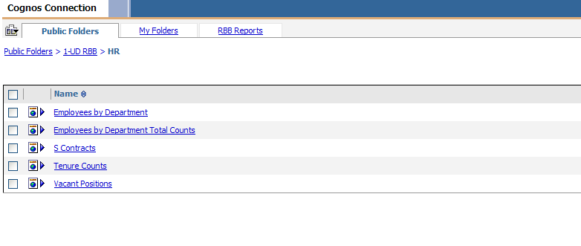
HR Reports

Slide 18
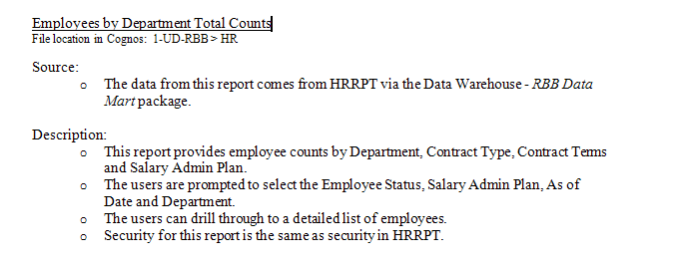
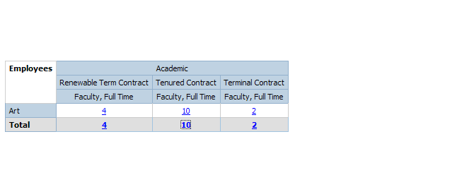
Employee By
Department
Counts

Slide 19
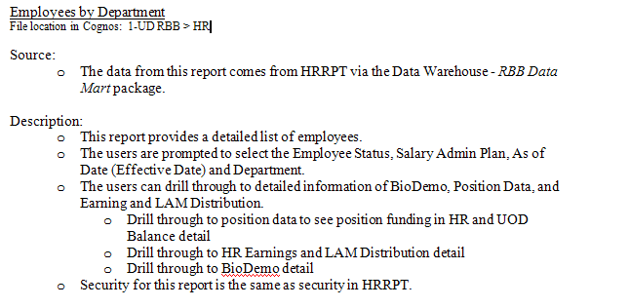
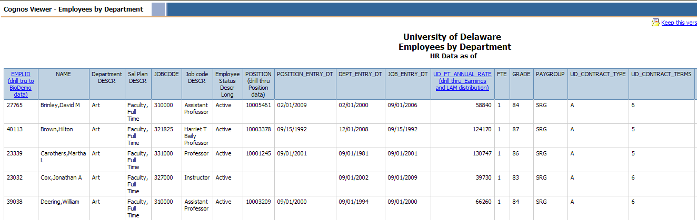
Employees By
Department

Slide 20
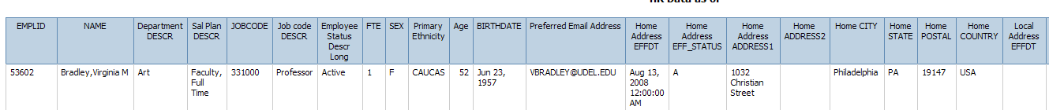
Drill to Bio Demo

Slide 21
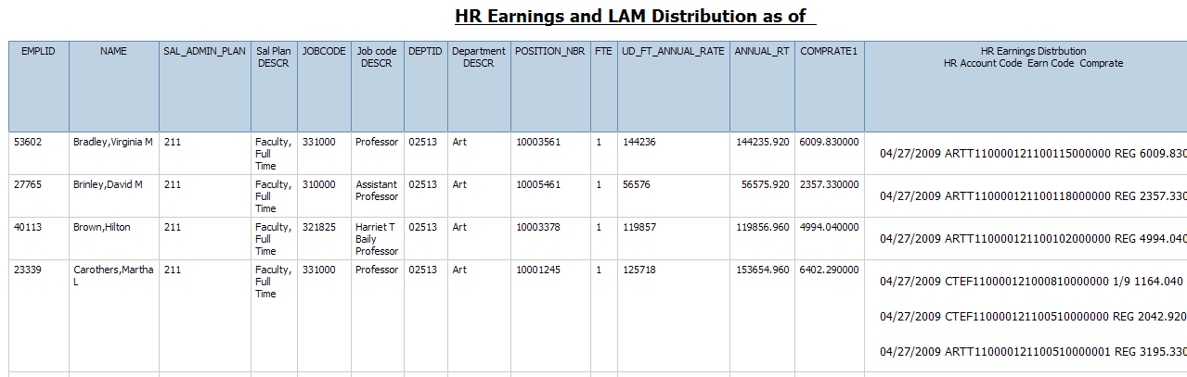
Drill to HR Earnings and LAM

Slide 22
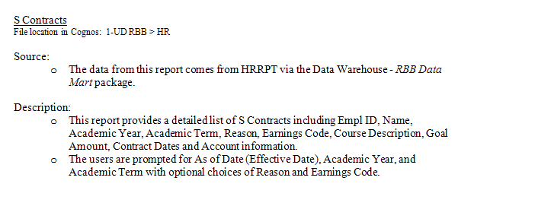
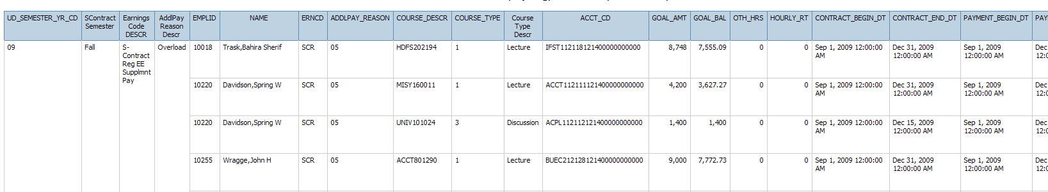
S Contract

Slide 23
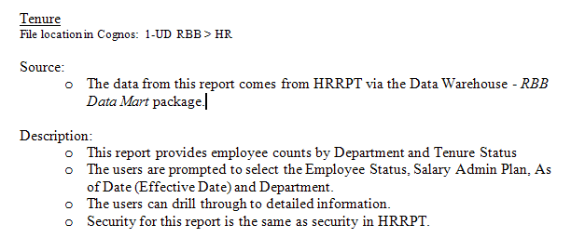
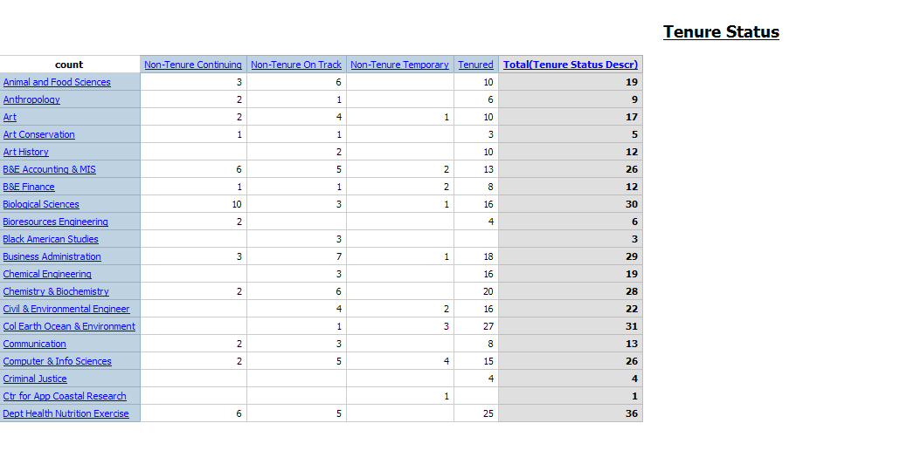
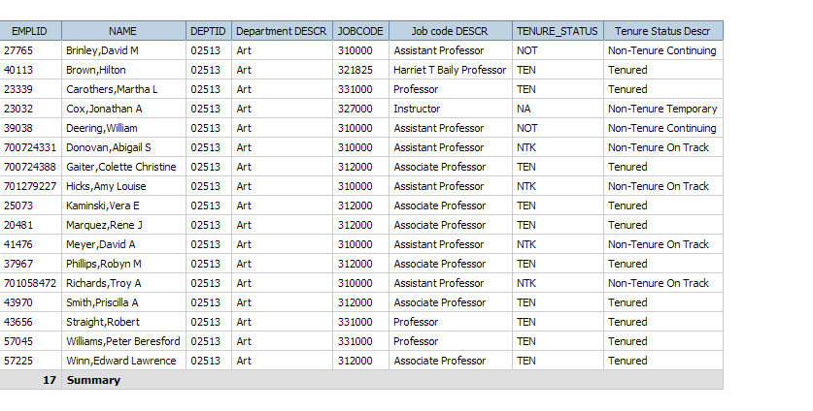
Tenure

Slide 24
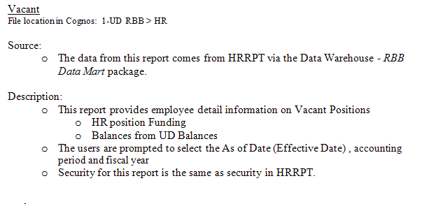
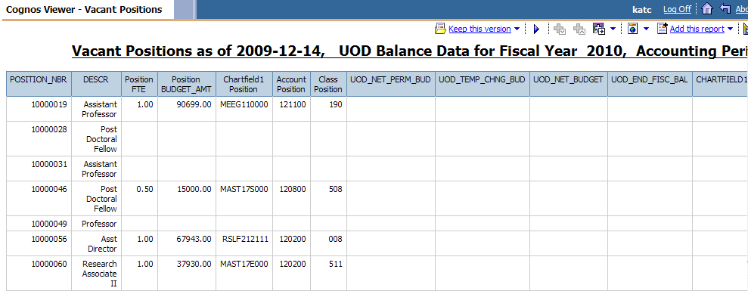
Vacant Positions

Slide 25
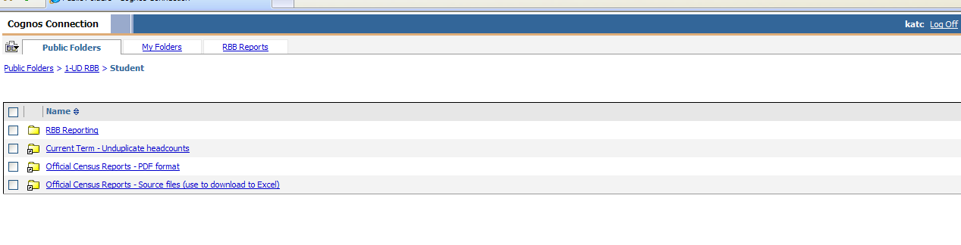
Student

Slide 26
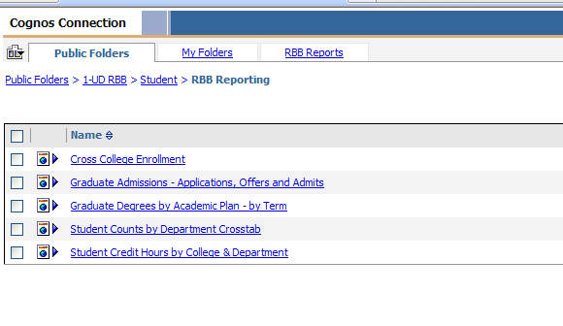
Student > RBB Reporting

Slide 27
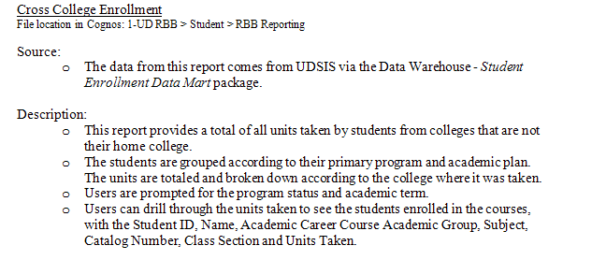
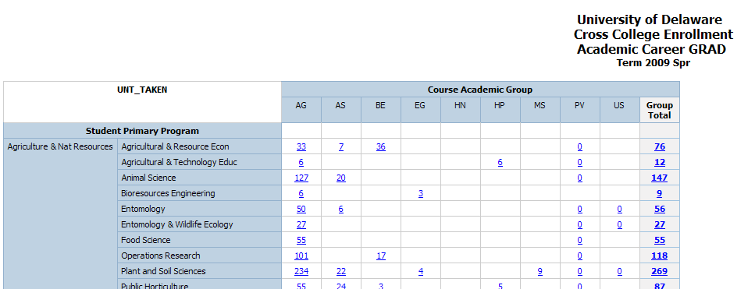
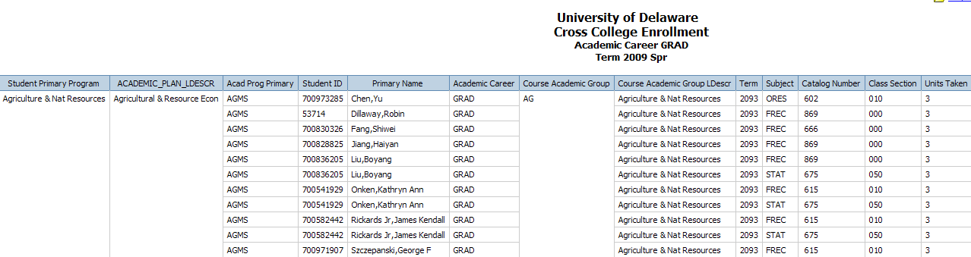
Cross College
Enrollment
Graduate Students

Slide 28
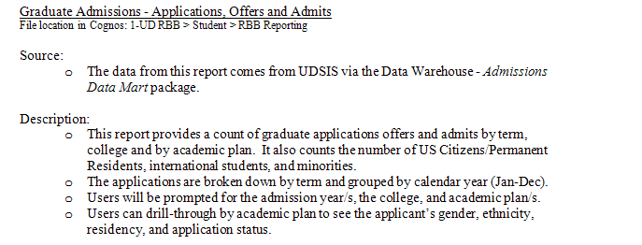
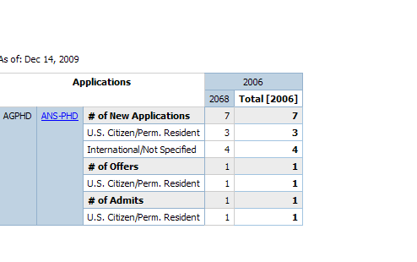
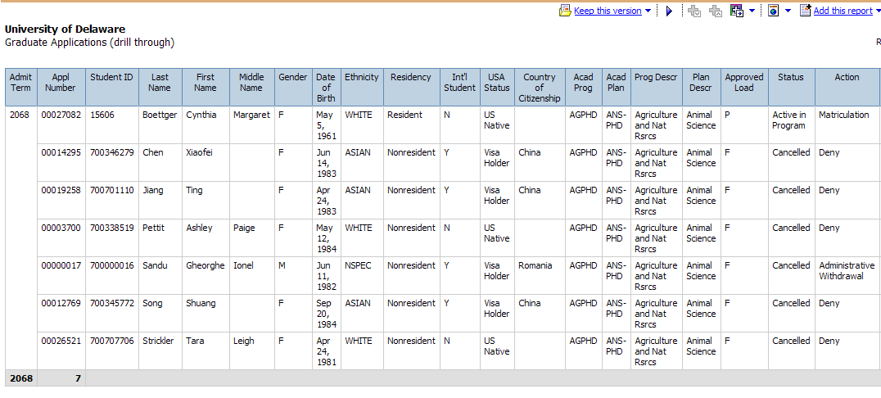
Graduate Admissions
Applications, Offers and Admits

Slide 29
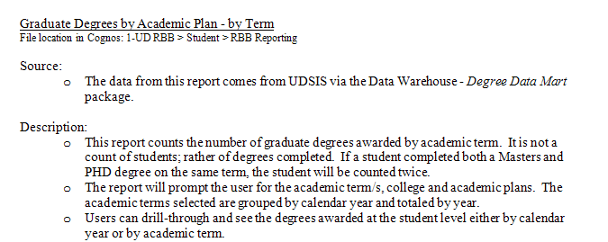
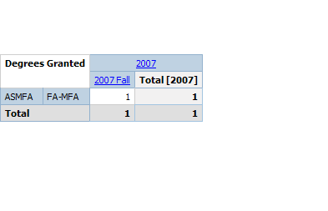
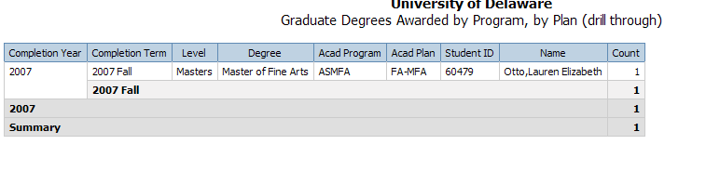
Graduate Degrees by Academic Plan by Term

Slide 30
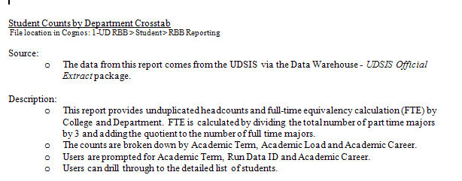
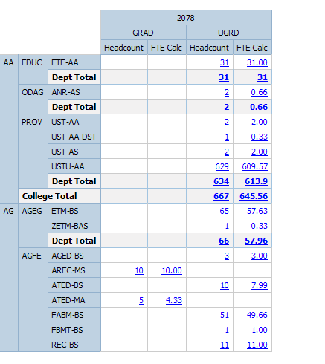
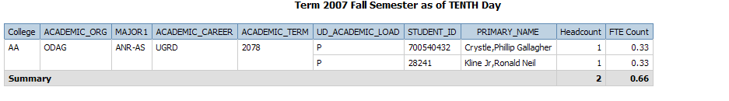
Student Counts by Department

Slide 31



Student Credit
Hours by College and Department

Slide 32
ICOR
Instructor College of Record
  Based on Student’s enrollment
  Overload(paid by S-Contract)
    College paying based of speedtype
      If payer not College
        Instructor home department in HR
          If not in College
            Owner of the course
  Regular Load
    Instructor home department in HR
        If not in College
          Owner of the course

Slide 33
Issues Reporting ICOR
Instructor
  Missing instructor data
  Incorrect workload
Pulling data from multiple systems
S-Contract
  Course may be missing/incorrect in HR
Rolling up to College level
  Not available in HR yet
Security
  HR for Instructor home department
  FIN for purpose/chartfield1

Slide 34
1 UD Course and Workload Verification
Report to validate instructor and workload
  Required to allow accurate ICOR reporting

Slide 35


Required Parameters

Slide 36

Course Verification

Slide 37
1 UD Student Admin
Reports to support Academic Management
  Reports created by various report writers
    Institutional Research
    Registrar Office
    Schedule of Classes
  Limited access to sensitive data
    Grades
    GPA
    Admissions

Slide 38
Where We Are Going
Fully Integrated Data Warehouse
  Seamless reporting from UDSIS, Financial and HR
Student Tracking System
  Changes in Careers
  Changes in Programs/Colleges
  Changes in Plans/Majors
Persisters
  Time to degree
Reports
  Dashboards and Scorecards

Slide 39
How Do We Get There
Fully Integrated Data Warehouse
  Verification of data in Financial and HR data marts
    Requires commitment from UD for testing
    Realistic testing plan based on user availability
    Commitment to address data and design issues
    Commitment from IT to support modifications, technical, and hardware issues

Slide 40
Student Tracking and Persisters
Currently under development
  Commitment from
    Institutional Research
    Registrars Office
    IT

Slide 41
Reporting Concerns
Implementation of Data Warehouse
  Data integrity
  Data Definitions
    Data governance committee
Security Issues
  HR
  Financial
Report vs. Data
  Standardizing reports across campus
  Decision Support System translating data into information.
  Access to Raw Data
  Input of report design
Dashboards and Scorecards
  Monitor and chart progress.
Training
  Power users vs. canned report users/viewers
    Few power users but require more training

Slide 42

Questions ?
Office of Institutional Research
Phone: 302-831-2021
www.udel.edu/IR
Kat Collison
Data Warehouse Manager
E-mail:
  katc@udel.edu
  ir-udew-it@udel.edu
12/15/2009

